Slide 1
Metric Spaces(contd)
Convergence, Cauchy Sequence, Completeness

Slide 4
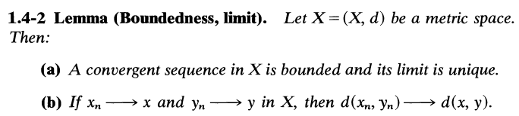

Slide 5
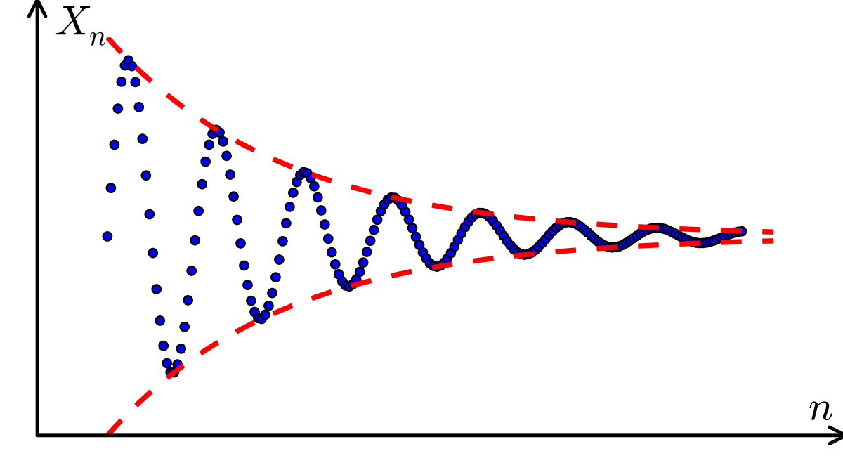

Slide 6
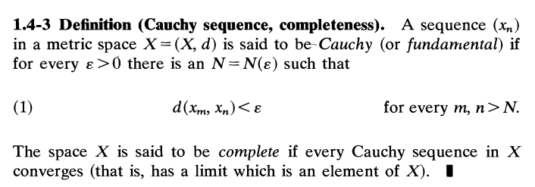
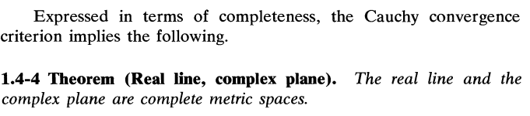

Slide 7
A few simple incomplete spaces which we can readily obtain are:
Omission of a point a from the real line
yields the incomplete space R -{a}.
More drastically, by the omission of all irrational numbers we have the rational line Q, which is incomplete.
An open interval (a, b) with the metric induced from R is
another incomplete metric space, and so on

Slide 8
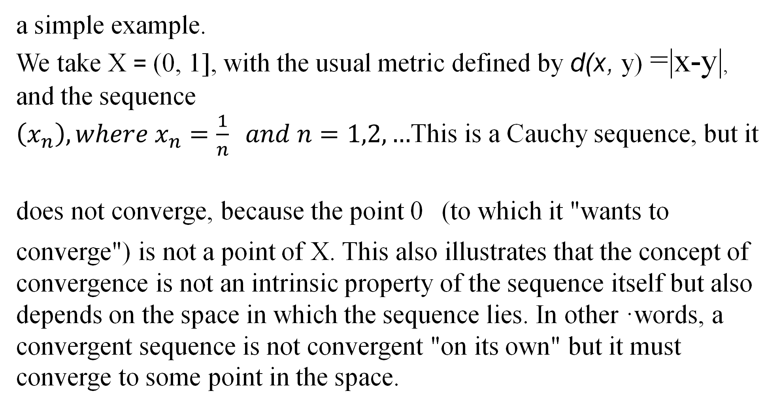
a simple example.
We take X = (0, 1], with the usual metric defined by d(x, y) =|x-y|, and the sequence
This is a Cauchy sequence, but it does not converge, because the point 0 (to which it "wants to
converge") is not a point of X. This also illustrates that the concept of
convergence is not an intrinsic property of the sequence itself but also
depends on the space in which the sequence lies. In other ·words, a
convergent sequence is not convergent "on its own" but it must
converge to some point in the space.

Slide 9
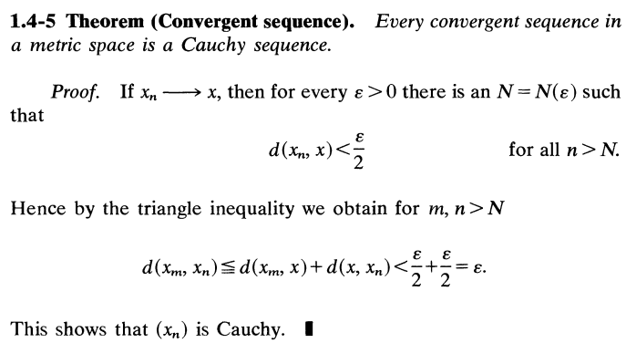

Slide 11























































Slide 12

















































































Slide 13




















































































sum
positive
quantities.

Slide 14






























































































Slide 15















Slide 16
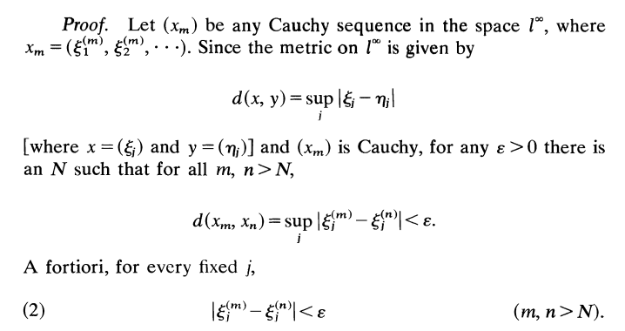

Slide 17
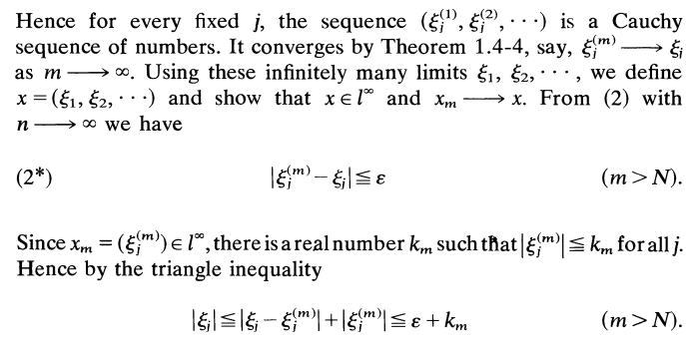

Slide 18
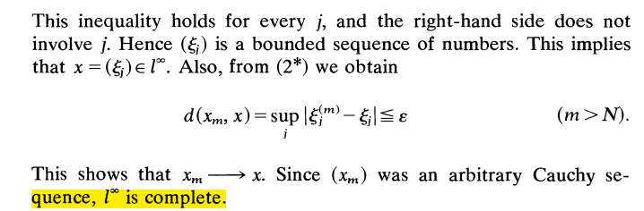

Slide 19


Slide 20
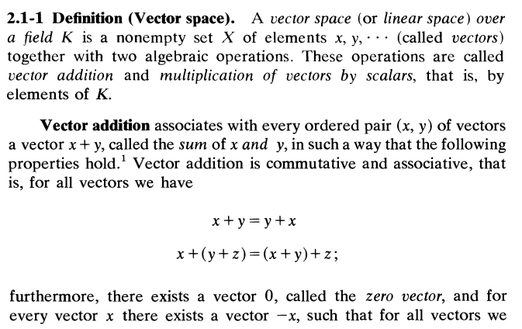

Slide 21
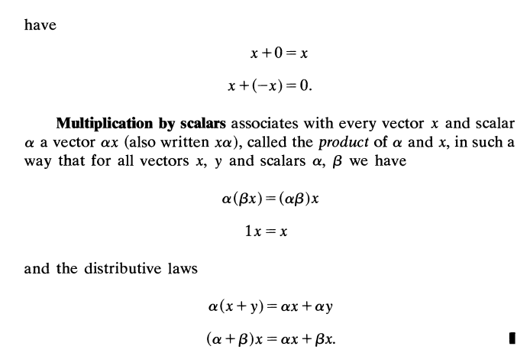

Slide 22
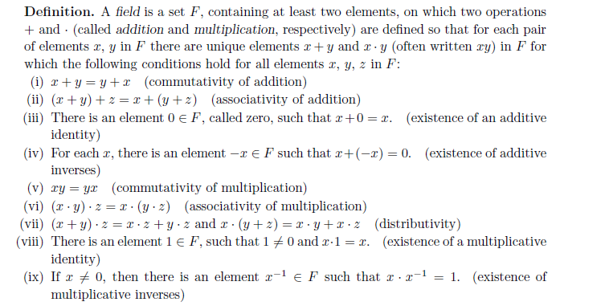

Slide 23
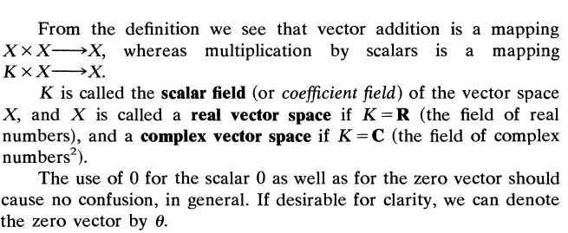

Slide 24
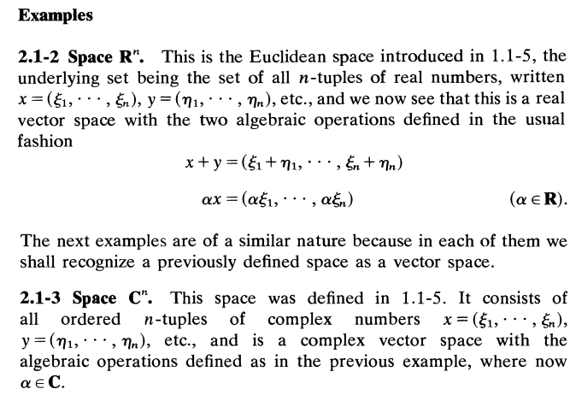

Slide 25
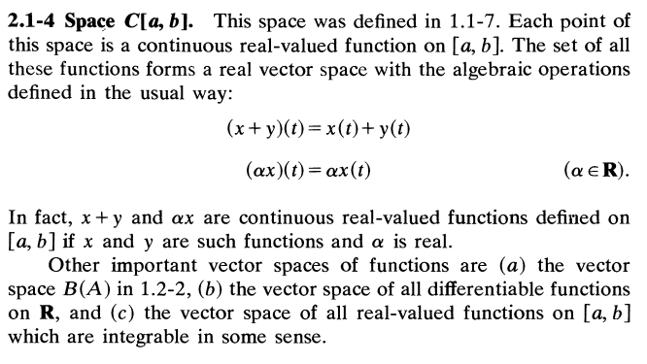

Slide 26
